Slide 1
Gabriel Galeote Checa
Project Flexible, Biocompatible, and Wirelessly Powered Implantable Optoelectronics | What I did last four weeks? Design final version of the circuit. Design antenna Write abstract for conference paper Developed conceptual model of the device.
Problem being faced? ANTENNA | What to do in next two weeks? Find a solution for the antenna. Final etching of the device.

Slide 2
Bioimplantable Device
Current work
The circuit is finished but we could improve the efficiency of the rectified signal as we have some artifacts in the input of the LDO.
Improve stability of the signal including a double half wave rectifier
Inc

Slide 3
Bioimplantable Device
1. Problems found
Soldering techniques: Wire-bonding and flip chip → Increases the manufacturing time so far
Problems found
Propagation Distance?
Configuration of the antenna
Antenna Gain?
How to reduce size?
Voltera machine: many problems with ink, cleaning of needles, weakness of needles…

Slide 4
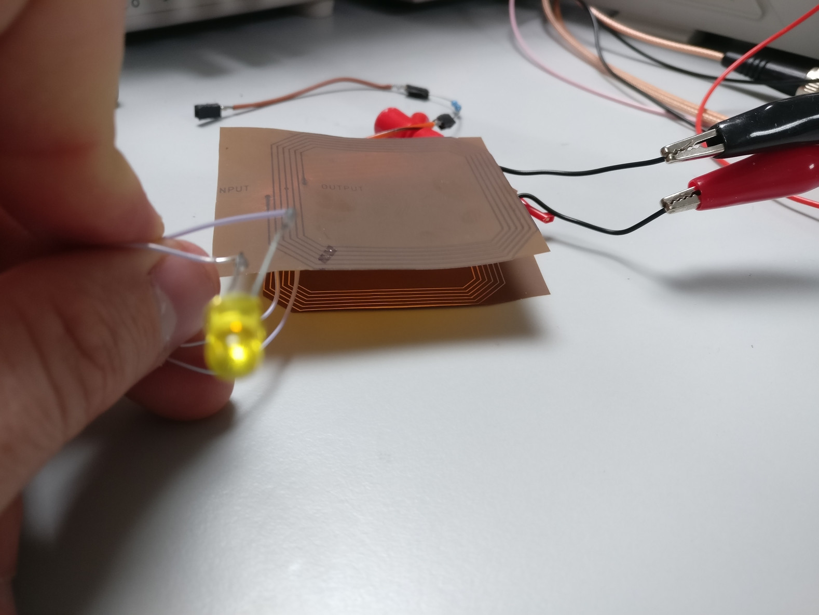
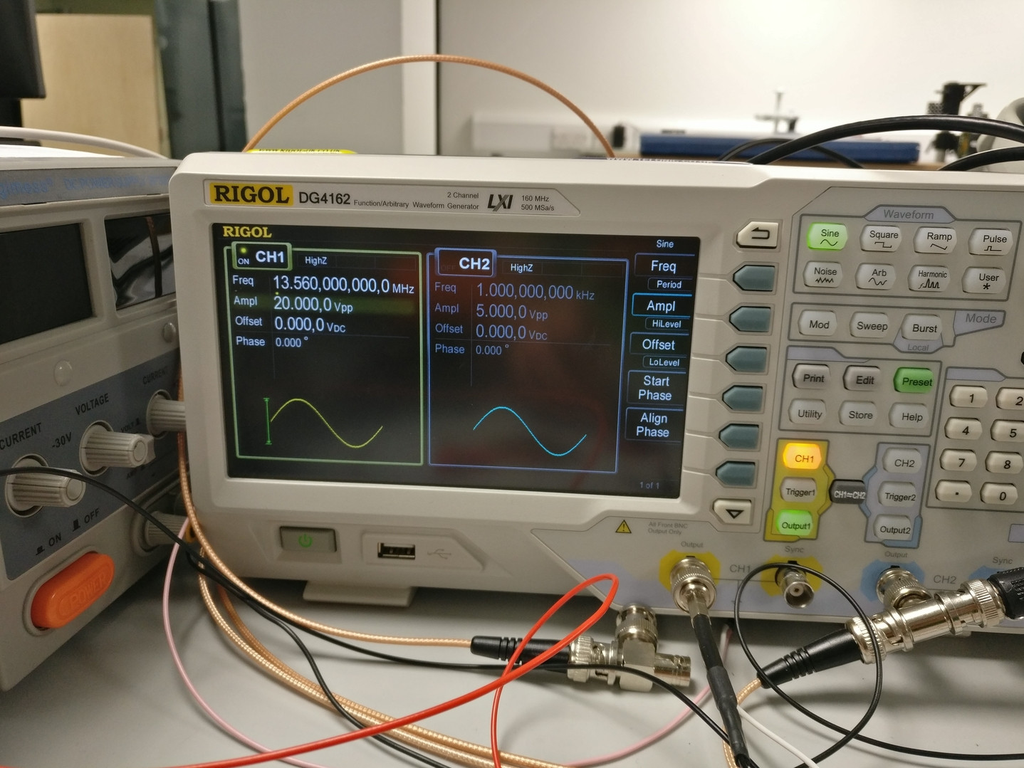
Bioimplantable Device
Power transfer between antennas

Slide 5
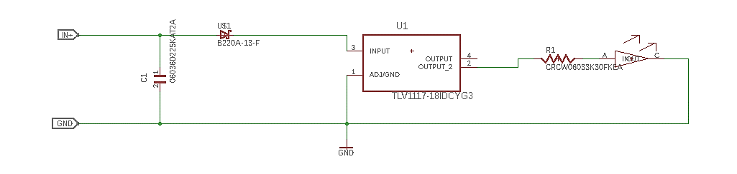
Bioimplantable Device
Basic Final Circuit design
Improvements?
Protection for the LDO ? (Capacitor at output and input? )→ Increase size
Some Ideas?

Slide 6
Bioimplantable Device
Possible improvements on the design:
Reduce implant size
Find an on-chip component to wrap everything in a chip
Change shape of the circuit
Design of the antenna
Reduce antena’s size → Increasing frequency?
2 frequency bands for power-data Transmission?
Substrate material
Use Polymide instead of Pyralux
Only posible mechanical properties improved?

